Slide 1

Cloud Architecture Patterns
Dima Ionut Daniel

Slide 2
Contents
What are Design Patterns ?
Challenges
Horizontally Scaling Compute Pattern
Queue-Centric Workflow Pattern
Auto-Scaling Pattern
MapReduce Pattern
Database Sharding Pattern
Busy Signal Pattern
Node Failure Pattern
Network Latency Primer
Colocate Pattern
Valet Key Pattern
CDN Pattern
Conclussion
Bibliography

Slide 3

What are Design Patterns ?
A software design pattern is a general reusable solution to a commonly occurring problem within a given context in software design.
Design patterns are formalized best practices that the programmer can use to solve common problems when designing an application or system.
Design patterns may be viewed as a structured approach to computer programming intermediate between the levels of a programming paradigm and a concrete algorithm.

Slide 4
Challenges
Availability
Data Management
Design and Implementation
Messaging
Management and Monitoring
Performance and Scalability
Resiliency
Security

Slide 5
Challenges (cont.)
Availability is the proportion of time that the system is functional and working, usually measured as a percentage of uptime.
It can be affected by system errors, infrastructure problems, malicious attacks, and system load.
Cloud applications typically provide users with a service level agreement (SLA), so applications must be designed to maximize availability.

Slide 6
Challenges (cont.)
Data management is the key element of cloud applications, and influences most of the quality attributes.
Data is typically hosted in different locations and across multiple servers for reasons such as performance, scalability or availability, and this can present a range of challenges.

Slide 7
Challenges (cont.)
The distributed nature of cloud applications requires a messaging infrastructure that connects the components and services, ideally in a loosely coupled manner in order to maximize scalability.
Asynchronous messaging is widely used, and provides many benefits, but also brings challenges such as the ordering of messages, poison message management, idempotency, etc.

Slide 8
Challenges (cont.)
Cloud applications run in in a remote datacenter where you do not have full control of the infrastructure and this can make management and monitoring more difficult than an on-premises deployment.
Applications must expose runtime information that administrators and operators can use to manage and monitor the system.

Slide 9
Challenges (cont.)
Performance is an indication of the responsiveness of a system to execute any action within a given time interval.
Cloud applications typically encounter variable workloads and peaks in activity.
Scalability concerns not just compute instances, but other elements such as data storage, messaging infrastructure, etc.

Slide 10
Challenges (cont.)
Resiliency is the ability of a system to gracefully handle and recover from failures.
The nature of cloud hosting, where applications are often multi-tenant, use shared platform services, compete for resources and bandwidth.
Detecting failures, and recovering quickly and efficiently, is necessary to maintain resiliency.

Slide 11
Challenges (cont.)
Security is the capability of a system to prevent malicious or accidental actions outside of the designed usage, and to prevent disclosure or loss of information.
Applications must be designed and deployed in a way that protects them from malicious attacks, restricts access to only approved users, and protects sensitive data.

Slide 12
Horizontally Scaling Compute Pattern
The pattern focuses on horizontally scaling compute nodes.
Primary concerns are efficient utilization of cloud resources.
To use efficiently the resources stateless compute nodes can be used.
Stateless nodes do not imply a stateless application.

Slide 13
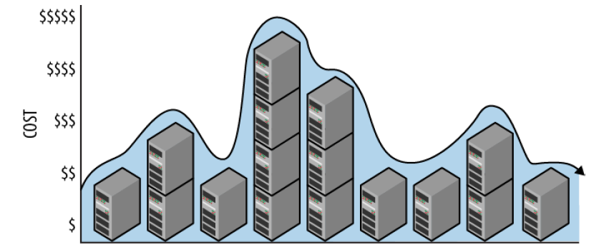
Horizontally Scaling Compute Pattern
Scaling can be achieved using cloud platform management user interface, scaling tools, etc.
The management service requires that a specific configuration is specified that indicates the number of nodes.
Scalability has been about adding capacity.
The terms vertical scaling and scaling up are synonyms, as are horizontal scaling an scaling out.

Slide 14
Queue-Centric Workflow Pattern
Used to loose coupling which focuses on asynchronous delivery of command requests sent from frontend to backend services.
Useful for processing updates that are time consuming, resource intensive or depend on remote services.
It's used in web applications to decouple communication between web and service tier.

Slide 15
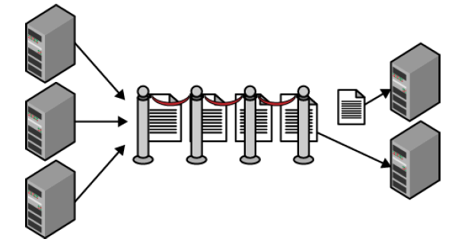
Queue-Centric Workflow Pattern
Commands are sent as messages over queue.
The queue only performs 2 operations: adding and removing of the command messages.
The queue can be FIFO(first in, first out).

Slide 16
Queue-Centric Workflow Pattern
The web tier adds messages to the queue.
The service tier removes and processes messages from the queue.
The number of command messages in the queue can differ based on the buffer between the 2 tiers.
The queue itself is reliable and wont't lose data.

Slide 17
Auto-Scaling Pattern
It's used for automatic scaling witch is more practical and cost-efficient.
Continuous monitoring of fluctuating resources is needed to maximize cost savings and avoid delays.
Frequent scaling requirements involve cloud resource such as compute nodes, data storage, queues or other elastic components.
This pattern assumes a horizontally scaling architecture and an environment that is friendly to reversible scaling.

Slide 18
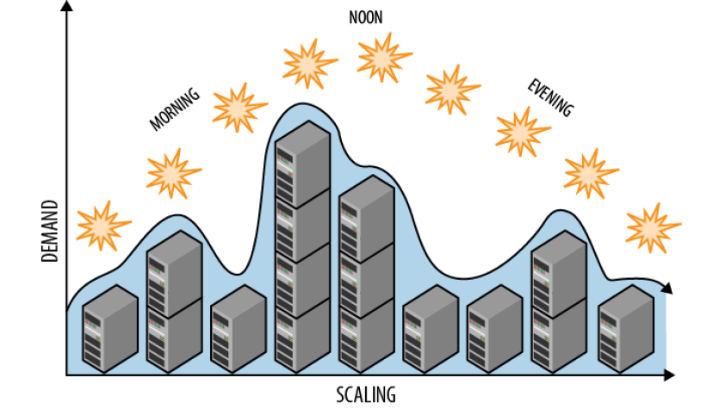
Auto-Scaling Pattern
Compute nodes are the most common resource to scale.
Auto-scaling can maintain the right resources and with minimum human intervertion it requires proper schedule for known events.

Slide 19
MapReduce Pattern
It's main focus is applying the MapReduce data processing pattern.
MapReduce is explictly tied to the use of Hadoop.
MapReduce is a data processing approach that is used for parallel processing of big data sets.
It's implemented as a cluster with many nodes working in parallel on different parts of the data.

Slide 20
MapReduce Pattern
MapReduce requires writing 2 functions: mapper and reducer which transforms data.
MapReduce is designed for batch processing of data sets.
The limiting factor is the size of the cluster.
Application processes large volumes of data stored in the cloud.
Application requires reports that reporting tools cannot efficiently create because the input data is to large or it's not in a compatible structure.

Slide 21
MapReduce Pattern
Hadoop implements MapReduce as a batch-processing system.
It's optmized for the processing of massive amounts of data, not for response time.
The output from MapReduce is flexible, used for data mining, for reporting or for other purposes.
Amazon WebServices, Google and Windows Azzure all have MapReduce as on-demand service.

Slide 22
Database Sharding Pattern
Focuses on horizontally scaling data through sharding.
Sharding means starting a single DB and then divvy up its data accross 2 or more DB(shards).
Each shard has the same DB schema as the original DB.
Data is distributed such that each row appears in exactle one shard.
The combined data from all shards is the same as the data from the original database.

Slide 23
Database Sharding Pattern
Traditional (non-shared) databases are deployed to a single database server node.
Any database running on a single node is limited by the node capacity.
There are many approaches for scaling an application DB when a single node is no longer sufficient.
Sollutions: distributing query load to slave nodes.
To handle query load, slave nodes are replicated from a master DB.

Slide 24
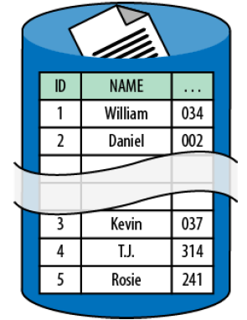
Database Sharding Pattern
Another option is splitting into multiple databases according to the type of data.
The Database Sharding Pattern is a horizontal scaling approach that overcomes the capacity limits of a single database node by distributing the database across multiple database nodes.
Each node contains a subset of data(shard).
The full set of shards represents the logic database.

Slide 25
Database Sharding Pattern
In sharding all resources from each shard(node) contribute to the overall capacity of the shared database.
Data rows are distributed across shards.
A specific database column designated as the shard key determines which shard node stores any particular database row.
The shard key is needed to access data.

Slide 26
Busy Signal Pattern
Focuses on how application should react when a cloud service responds to a request with a busy signal rather than success.
The client is programatically making a request to a service but the service replies with a busy signal.
A transient failure is a short-lived failure that isn't the fault of the client.
For cloud services, limits aren't a problem except for very busy applications.
Limits in cloud services can be exceeded by an individual client or by multiple clients collectively.

Slide 27
Busy Signal Pattern
Throttling is a self-defense response by services to limit or slow down usage.
For cloud services accessed over HTTP the proper reject of an request is with 503 Service Unavailable.
For a DB service accessed over TCP the databaase connection can be closed.

Slide 28
Busy Signal Pattern
Once the busy signal is detected the application can:
retry immediately with no delay
retry after (fixed or random) delay
retry with increasing delays(linear or exponential backoff)
throw an exception

Slide 29
Busy Signal Pattern
Access to a cloud service involved traversing a network that already has short delay.
An immediate retry approach is appropiate if failures are rare.
The leasth aggresive retry approach is retry with increasing delays.

Slide 30
Node Failure Pattern
Focuses on how application should respond when the compute node fails or shuts down.
Some common reasons for shutdown are unresponsive application due to application failure, routine maintenance activities, etc.
Application that are using Auto-Scaling Pattern requires graceful shutdown of compute nodes.

Slide 31
Node Failure Pattern
It's best to use N+1 rule which assures the high availability.
If N nodes are needed to support user demand then deploy N+1 nodes.
One node can fail or be interrupted without impact to the application.

Slide 32
Network Latency Primer
Network latency represents the time it taks to transmit data across network.
Network latency slows down the applications.
The effectsd of network latency can vary based on the user's greographical location.

Slide 33
Network Latency Primer
Ping is a simple tool for testing bandwidth.
In cloud applications we can decrease the network latency using:
caching
data compressions
predictive fetching
background processing

Slide 34
Network Latency Primer
Also we can reduce network latency by:
moving application closer to users
moving application data closer to users
ensuring nodes within the application are closer together

Slide 35
Colocate Pattern
Focuses on avoiding unnecessary network latency.
In cloud, "close" means in the same data center.
It's best to minimize network latency across tiers by colocating them in the same data center.
This helps maximize performance between these tiers and can avoid the costs of cloud provider data transmission.

Slide 36
Valet Key Pattern
Focuses on efficiently using cloud storage services with untrusted clients.
This pattern enables specifying that a user is allowed to access specific areas within cloud storage account with specific permissions for a limited amount of time.
Cloud storage services simplify transferring data between untrusted clients and to secure data storage.

Slide 37
Valet Key Pattern
Access to cloud storage services is a privileged operation.
Securing and managing access to data is always a high priority, but there is also a tension between security and efficiency.
The pattern focuses on securely using blob storage while also reading and writing data with maximum efficiency.

Slide 38
CDN Pattern
Focuses on reducing network latency for accessing files through globally distributed edge caching.
The goal is to speed up delivery of application content to users.
The Content Delivery Network (CDN) is a service that functions as a globally distributed cache.
CDN keeps copies of application files in multiple places.

Slide 39
CDN Pattern
CDN is not effective for use on resources that change constantly.
A CDN is only efficient for use on resources that are accessed at least twice before expiring from CDN cache.
The CDN stores copies of resources with a specified expiration date.

Slide 40
Conclussion
Patterns offers a reusable solution for a particular problem.

Slide 41

Bibliography
http://www.cloudcomputingpatterns.org/cloud_application_architectures/
http://www.cloudpatterns.org/
https://docs.microsoft.com/en-us/azure/architecture/patterns/
O’Reilly - Cloud Architecture Patterns

Slide 42
Questions ?

